Slide 1

Practical Clustered Shading
Emil Persson
Head of Research, Avalanche Studios

Slide 2
Practical Clustered Shading
History of lighting in the Avalanche Engine
Why Clustered Shading?
Adaptations for the Avalanche Engine
Performance
Future work

Slide 3
Lighting in Avalanche Engine
Just Cause 1
Forward rendering
3 global pointlights
Just Cause 2, Renegade Ops
Forward rendering
World-space XZ-tiled light-indexing
4 lights per 4m x 4m tile
128x128 RGBA8 light index texture
Lights in constant registers (PC/Xenon) or 1D texture (PS3)
Per-object lighting
Customs solutions
Notes:
Just Cause 1 had 3 global pointlights. This meant that if, for instance, three streetlights were enabled and you fired your gun, one of the lights would shut off for the duration of the gun flash. Clearly, this solution was hardly ideal.
For Just Cause 2 we switched to a world-space 2D tiled solution where light indexes were stored in texels. The technique has been described in detail in the article ”Making it Large, Beautiful, Fast, and Consistent: Lessons Learned Developing Just Cause 2” in GPU Pro. This technique was actually in some ways similar to clustered shading, although much more limited and designed around DX9 level hardware. It worked reasonably well on platforms with decent dynamic branching, such as PC and Xenon, whereas the PS3 struggled. Ultimately this caused us to implement numerous workarounds to get PS3 running well, so that in the end this technique mostly ended up being a fallback option if the light count was too high for a specialized shader to work. The amount of specialized shaders also became quite a bit of a maintenance problems, and figuring out the light count a performance issue on the CPU side.

Slide 4
Lighting in Avalanche Engine
Post-JC2
Classic deferred rendering
3-4 G-Buffers
Flexible lighting setup
Point lights
Spot lights
Optional shadow caster
Optional projected texture
Area lights
Fill lights
Transparency a big problem
Old forward pass still polluting the code
FXAA for anti-aliasing
Notes:
After Just Cause 2 we ended going the deferred shading route, initially using classic deferred. This worked relatively well for current generation hardware and allowed us to support many more lights, different light types, shadow casting dynamic lights etc. This was great, but naturally we also got all the downsides of deferred shading, such as problems with transparency, problems with custom material or lighting models, as well as large increase in memory. Initially we supported MSAA, but ultimately we dropped it in favor of FXAA for performance and memory reasons.
Unfortunately, the old forward pass also had to stick around for transparency to work reasonably well, although it only ever supported pointlights and the lighting doesn’t quite match the much more sophisticated deferred pass. This led us to start looking into alternatives going forward, especially with a new generation consoles on the horizon.

Slide 5
Solutions we've been eyeing
Tiled deferred shading
Production proven (Battlefield 3)
Faster than classic deferred
All cons of classic deferred
Transparency, MSAA, memory, custom materials / light models etc.
Less modular than classic deferred
Forward+
Production proven (Dirt Showdown)
Forces Pre-Z pass
MSAA works fine
Transparency requires another pass
Less modular than classic deferred
Clustered shading
Not production proven (yet)
No Pre-Z necessary
MSAA works fine
Transparency works fine
Less modular than classic deferred
Notes:
Tiled Deferred Shading and Forward+ (Tiled Forward Shading) are production proven and has shipped in real games, but they come with a bunch of drawbacks. Tiled deferred offers better performance than classic deferred, but doesn’t really solve any of our problems since all drawbacks of classic deferred stays around. In addition, it also imposes a new restriction in that all lights, and consequently shadow buffers, are now required up-front. However, this is a property it shares with all other techniques, including Forward+ and Clustered Shading, and even our old forward solution from JC2.
Forward+ has the advantage of working well with MSAA without hassles; however, while it can be made to work with transparency, it requires an extra pass, including another round of pre-z. The requirement of a full pre-z pass for this technique to work made this a non-starter for us. We didn’t bother implementing it for evaluation purposes as a full pre-z pass is not an option for us. We did at one point have a fairly complete pre-z pass in Just Cause 2, but over the development the pre-z pass was continuously trimmed until very little remained. The additional overhead just didn’t pay off, and the large increase in draw-call count was problematic. After we got a decent occlusion culling system in place there were very few cases pre-z did not, in fact, result in a performance drop. Pre-z is now only enabled on a handful of things specifically marked for pre-z by content creators, and a few code-driven systems that need it for other reasons.
Clustered Shading has the advantage of not requiring a pre-z pass, even in its forward incarnation, while working well with MSAA and transparency out of the box with no particular tricks or hacks. It has at the point of this writing to our knowledge not shipped in any real games so far, but it has been in production at Avalanche Studios since January 2013 and has so far worked really well for us and we expect it to make it all the way to shipping.

Slide 6
Why Clustered Shading?
Flexibility
Forward rendering compatible
Custom materials or light models
Transparency
Deferred rendering compatible
Screen-space decals
Performance
Simplicity
Unified lighting solution
Actually easier to implement than full blown Tiled Deferred / Forward+
Performance
Typically same or better than Tiled Deferred
Better worst-case performance
Depth discontinuities? “It just works”
Notes:
Clustered Shading is really decoupled from the choice between deferred or forward rendering. It works with both, so you’re not locked into one or the other. This way you can make an informed choice between the two approaches based on other factors, such as whether you need custom materials and lighting models, or need deferred effects such as screen-space decals, or simply based on performance.
The two tiled solutions need quite a bit of massaging to work reasonable well in all situations, especially with large amounts of depth discontinuities. There are proposed solutions that mitigate the problem, such as 2.5D culling, but they further complicate the code. For Clustered Shading it just falls out automatically and depth discontinuities do not cause performance problems. This allows Clustered Shading to maintain a more stable frame-rate regardless of scene depth complexity.

Slide 7
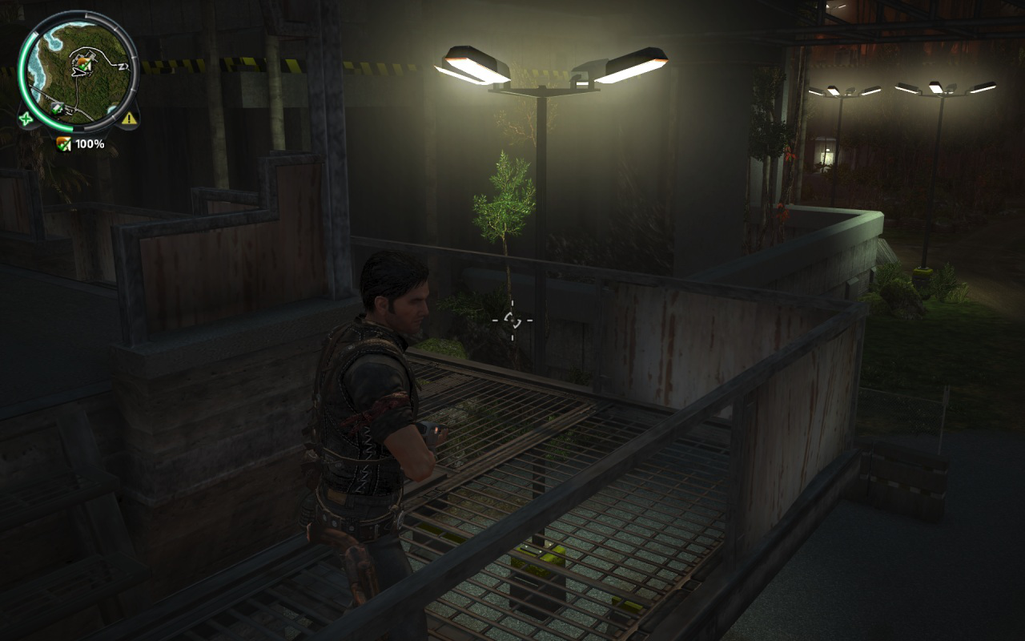
Depth discontinuities
Notes:
Since we can’t show any screenshots of what we’re working on at this point, the problem will be illustrated with Just Cause 2. This is what I got when I just launched my last save-game from the retail game. I didn’t have to go look for a problematic area, in fact, it was right there in front of my face. This shows how common these scenes actually are in real games, and certainly so in the games that we make.

Slide 8
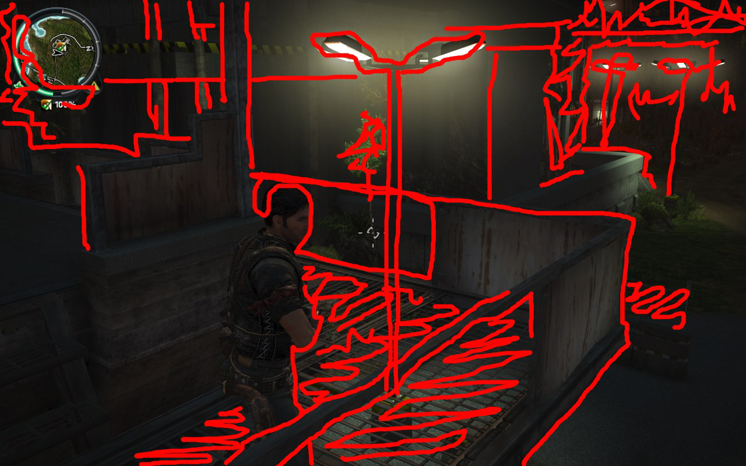
Depth discontinuities
Notes:
Here a number of large depth differences have been manually painted over the image to illustrate where you might expect a problem for tiled shading techniques. As you can see, they are fairly common and affect a fairly large part of the screen. The lattice the player is standing on is a typical example of a common piece of game art that would cause problems for tiled techniques. Foliage is another typical source of pain.

Slide 9
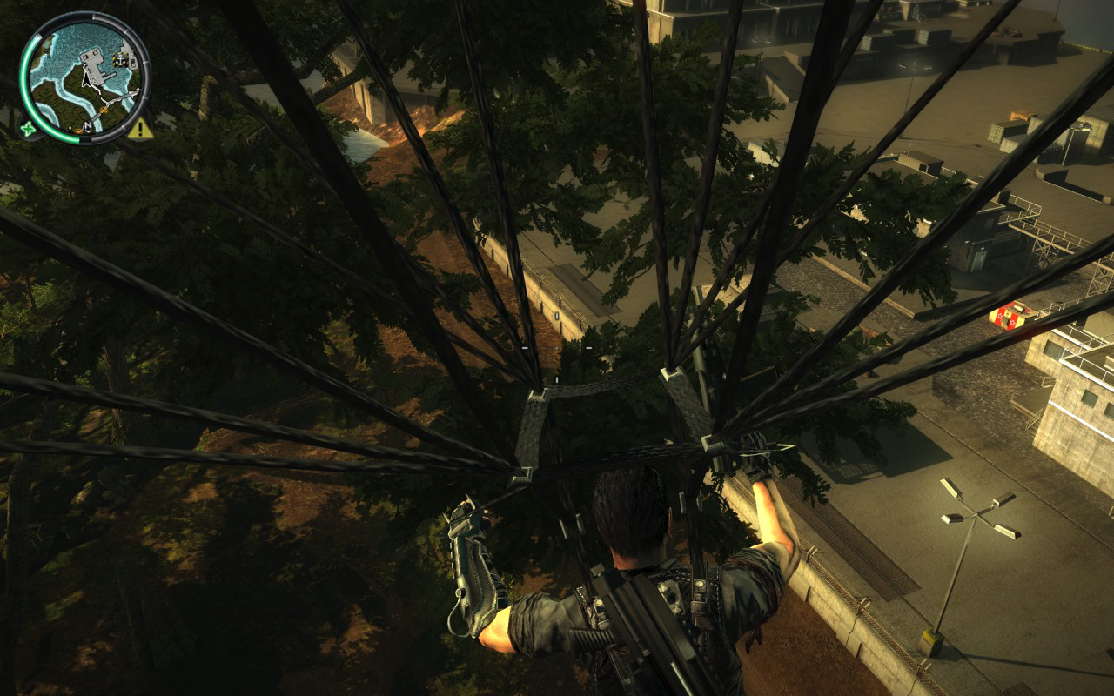
Depth discontinuities
Notes:
If you’ve played Just Cause 2, you know that this sort of scenario is actually quite common, and obviously problematic from a depth discontinuity point of view.

Slide 10
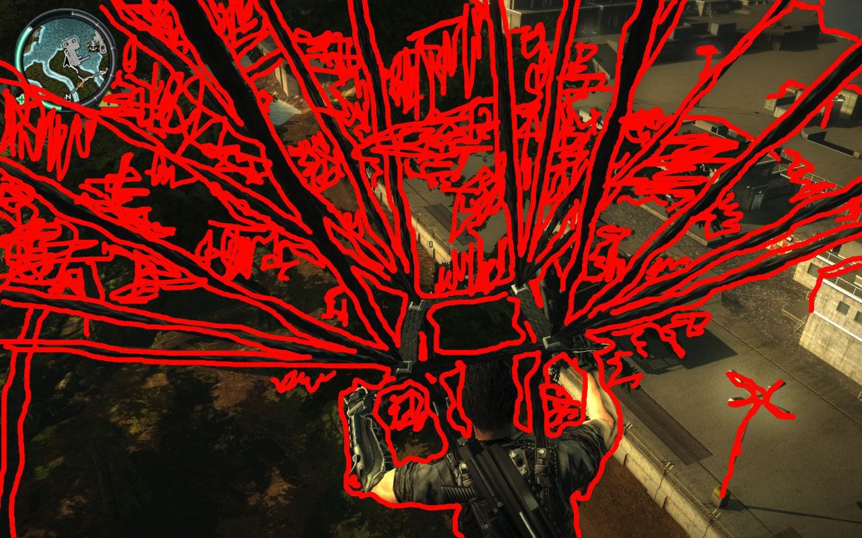
Depth discontinuities
Notes:
And here we can see that in this scene, pretty much the whole screen is filled of areas that would be much more expensive to shade with the tiled techniques than with clustered.

Slide 11
Practical Clustered Shading
What we didn't need
Millions of lights
Fancy clustering
Normal-cone culling
Explicit bounds
What we needed
Large open-world solution
No enforced Pre-Z pass
Spotlights
Shadows
What we preferred
Work with DX10 level HW
Tight light culling
Scene independence
Notes:
The original paper was written by academics, and naturally the direction of their research doesn’t match 100% with the requirements of the a game engine. We don’t have millions of tiny lights, but between hundreds and thousands of mostly artist placed lights, that are on a human scale. This meant that tight culling, so as to not add lights to more clusters than necessary, became more important to us. The higher-order clustering options the paper explored (and also largely rejected) were also something that we didn’t expect to work for us. Deriving the explicit cluster bounds was something that could be interesting, but we found that sticking to implicit bounds simplified the technique, while also allowing the light assignment to run on the CPU. This enables DX10 level GPU compatibility, which may be important given that (as of this writing) 33% on Steam are still on a DX10 GPU. In addition, this gives us scene independence. This means that we don’t need to know what the scene looks like to fill in the clusters, and this also allows us to evaluate light at any given point in space, even if it’s floating in thin air. This could be relevant for instance for ray-marching effects.
The paper only explored pointlights, whereas we need spotlights as well. We also needed a shadow solution, which the original paper also did not explore. Finally, our games are massively large while still being played on human scale, resulting in a depth span from very near to very far, which required some extra fiddling to get rolling with clustered shading.

Slide 12
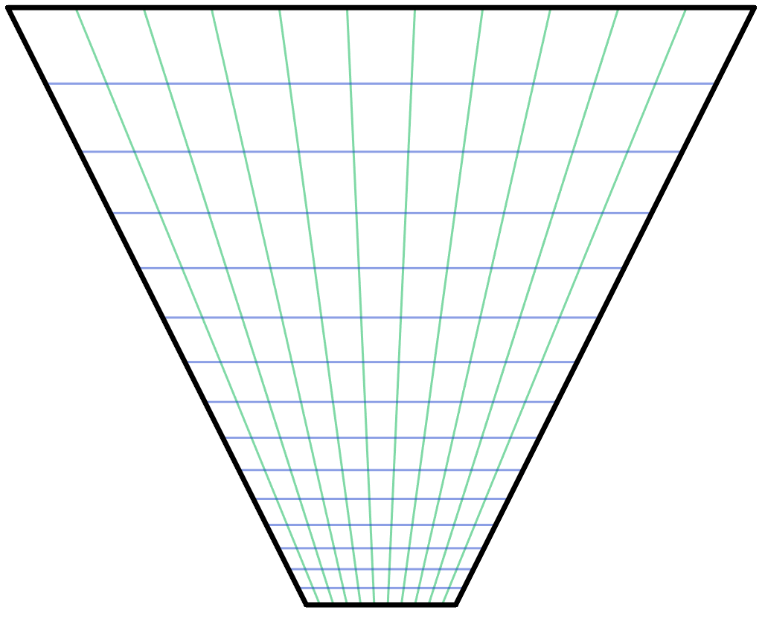
The Avalanche solution
Still a deferred shading engine
But unified lighting solution with forward passes
Only spatial clustering
64x64 pixels, 16 depth slices
CPU light assignment
Works on DX10 HW
Allows compacter memory structure
Implicit cluster bounds only
Scene-independent
Deferred pass could potentially use explicit
Notes:
We are still using a deferred engine, but we could change to forward at any time should we decide that to be better. The important part is, however, that the transparency passes can now use the same lighting structure as the deferred passes, making it a unified lighting solution. Since we are still using deferred, and thus obviously have a complete depth buffer once we get to the deferred lighting pass, we could potentially use explicit bounds there. We still haven’t explored that opportunity, but it’s an option. It’s unclear if computing the explicit bounds, plus an extra round of culling, is going to be outweighed by potentially faster light evaluation.
Currently we are using 64x64 screen-space tiles, and 16 depth slices. This is most likely going to change, primarily because currently the tiles are currently fairly long and thin, and this is not optimal for a culling, in particular for spotlights.

Slide 13
The Avalanche solution
Exponential depth slicing
Huge depth range! [0.1m – 50,000m]
Default list
[0.1, 0.23, 0.52, 1.2, 2.7, 6.0, 14, 31, 71, 161, 365, 828, 1880, 4270, 9696, 22018, 50000]
Poor utilization
Limit far to 500
We have a “distant lights” systems for light visualization beyond that
[0.1, 0.17, 0.29, 0.49, 0.84, 1.43, 2.44, 4.15, 7.07, 12.0, 20.5, 35, 59, 101, 172, 293, 500]
Special near 0.1 – 5.0 cluster
Tweaked visually from player standing on flat ground
[0.1, 5.0, 6.8, 9.2, 12.6, 17.1, 23.2, 31.5, 42.9, 58.3, 79.2, 108, 146, 199, 271, 368, 500]
Notes:
We are using exponential depth slicing, much like in the paper. There is nothing dictating that this is what we have to use, or for that matter that it is the best or most optimal depth slicing strategy; however, the advantage is that the shape of the clusters remain the same as we go deeper into the depth. On the other hand, clusters get larger in world space, which could potentially result in some distant clusters containing a much larger amount of lights. Depending on the game, it may be worth exploring other options.
Our biggest problem was that our depth ratio is massive, with near plane as close as 0.1m and far plane way out on the other side of the map, at 50,000m. This results in poor utilization of our limited depth slices, currently 16 of them. The step from one slice to the next is very large. Fortunately, in our game we don’t have any actual light sources beyond a distance of 500m. So we simply decided to keep our current distant light system for distances beyond 500m and limit the far range for clustering to that.
This improved the situation notably, but is still not ideal. We still burn half of our slices on the first 4 meters from the camera. Given how our typical scenes look like, that’s likely going to be mostly empty space in most situations. So to improve the situation, we made the first slice special and made that go from near plane to an arbitrary visually tweaked distance, currently 5m. This gave us much better utilization.

Slide 14
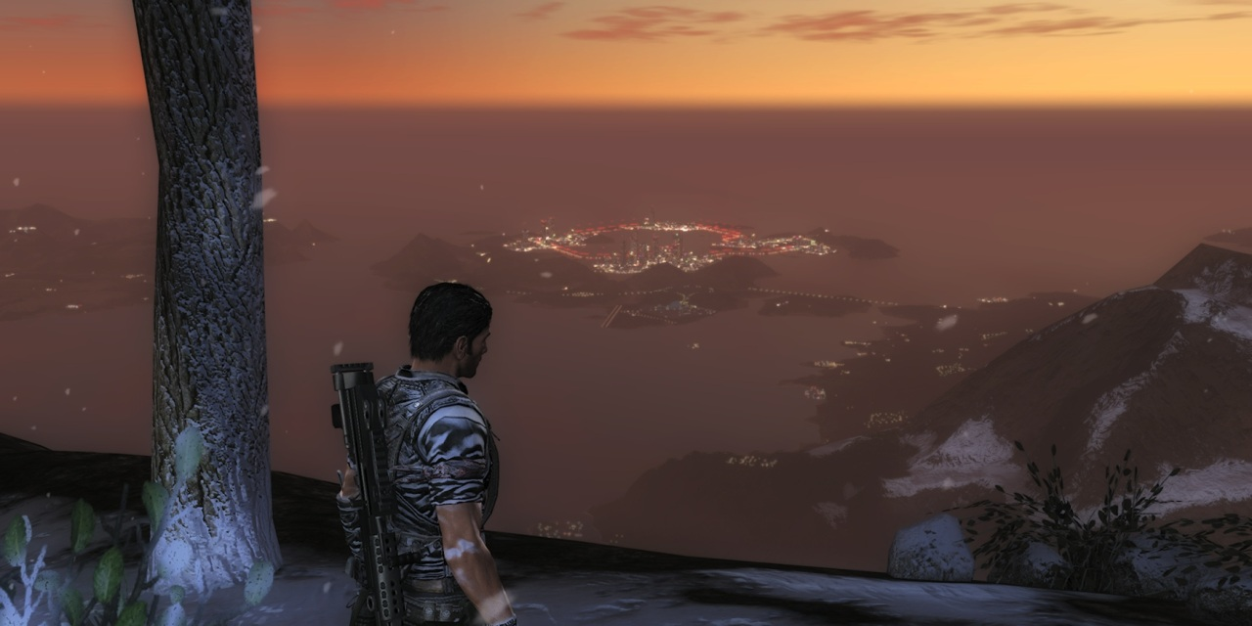
The Avalanche solution
Separate distant lights system
Notes:
This illustrates our distant light system, which has been around since Just Cause 2. In this screenshot there are likely no actual lights enabled since we’re far from civilization on top of a mountain, except perhaps our fake ”night light” that slightly illuminates the area around the player at night to help game-play a bit in the darkness. Everything in the distance though, while representing actual artist placed lights, the actual light sources aren’t loaded at this distance. They are simply stored as a very compact list of point sprites, resident in memory at all time, and which is very cheap to render. We are at this point still using the same forward rendering solution here as in Just Cause 2, but one option now that we are using deferred is to actually compute real lighting under those sprites instead of just a putting a blob from a texture there.

Slide 15
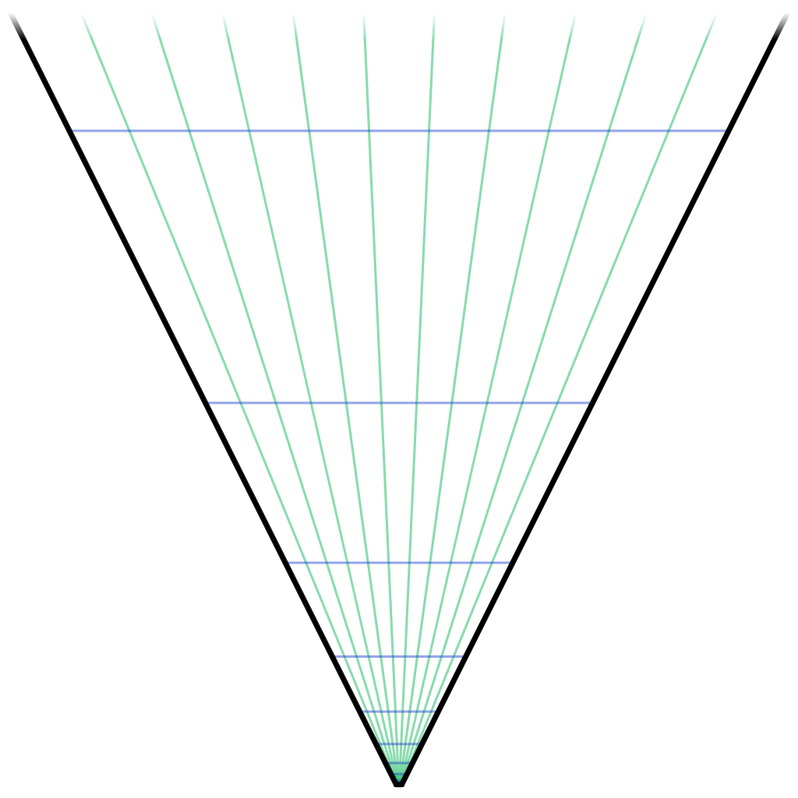
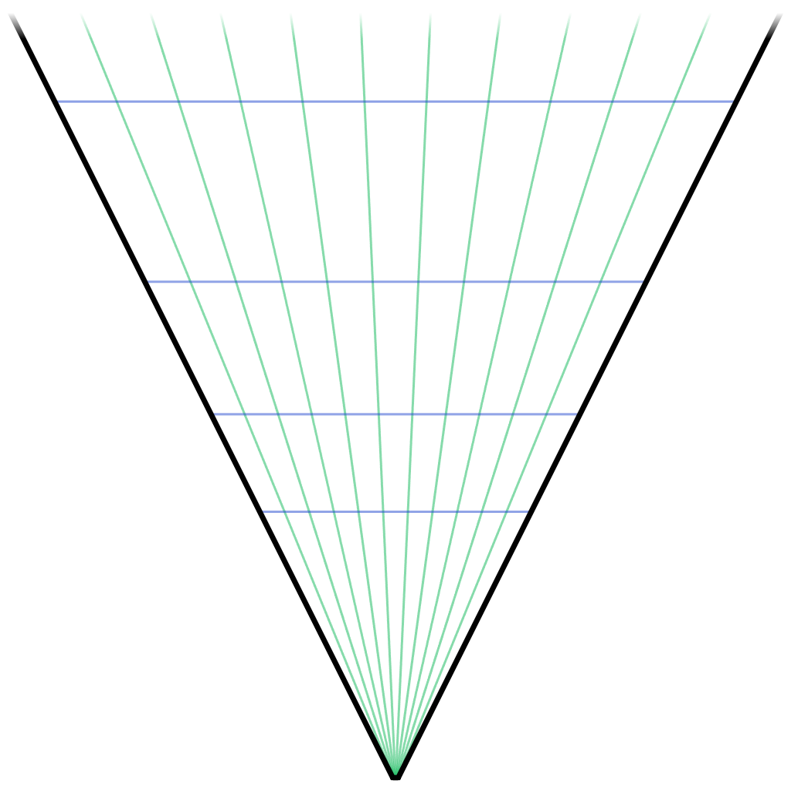
The Avalanche solution
Default exponential spacing
Special near cluster
Notes:
This illustrates the benefit of the special near cluster. Less slices are wasted, and the cluster shapes aren’t quite as long and thin.

Slide 16
Data structure
Cluster “pointers” in 3D texture
R32G32_UINT
R=Offset
G=[PointLightCount, SpotLightCount]
Light index list in texture buffer
R16_UINT
Tightly packed
Light & shadow data in constant buffer
PointLight: 2 ˣ float4
SpotLight: 3 ˣ float4
0, [2,1]
3, [1,3]
7, [0,0]
7, [1,0]
8, [1,1]
10, [2,1]
0
3
2
2
0
1
3
1
0
2
0
3
1
…
…
PointLight0
SpotLight0
PointLight1
SpotLight1
PointLight2
SpotLight2
PointLight3
SpotLight3
...
...
Notes:
Given a screen position and a depth value (whether from a depth buffer or the rasterized depth in a forward pass) we start by looking up the cluster from a 3D texture. Each texel represents a cluster and its light list. The red channel gives us an offset to where the light list starts, whereas the green channel contains the light counts. The light lists are then stored in a tightly packed lists of indexes to the lights. The actual light source data is stored as arrays in a constant buffer.
All in all the data structure is very compact. In a typical artists lit scene it may be around 20kb of data to upload to the GPU every frame.

Slide 17
Shader
int3 tex_coord = int3(In.Position.xy, 0); // Screen-space position ...
float depth = Depth.Load(tex_coord); // ... and depth
int slice = int(max(log2(depth * ZParam.x + ZParam.y) * scale + bias, 0)); // Look up cluster
int4 cluster_coord = int4(tex_coord >> 6, slice, 0); // TILE_SIZE = 64
uint2 light_data = LightLookup.Load(cluster_coord); // Fetch light list
uint light_index = light_data.x; // Extract parameters
const uint point_light_count = light_data.y & 0xFFFF;
const uint spot_light_count = light_data.y >> 16;
for (uint pl = 0; pl < point_light_count; pl++) { // Point lights
uint index = LightIndices[light_index++].x;
float3 LightPos = PointLights[index].xyz;
float3 Color = PointLights[index + 1].rgb;
// Compute pointlight here ...
}
for (uint sl = 0; sl < spot_light_count; sl++) { // Spot lights
uint index = LightIndices[light_index++].x;
float3 LightPos = SpotLights[index].xyz;
float3 Color = SpotLights[index + 1].rgb;
// Compute spotlight here ...
}
Notes:
This shows the shader code for rendering with this data structure. The input is just the screen-space position and depth. This shows a deferred pass where depth comes from a texture, but in a forward pass the second line of code would simple use In.Position.z instead. Everything else would be identical, which shows how easily this technique adapts to either deferred or forward.
The ZParam.xy here contains the same parameters that you would use to compute a linear depth from a Z-buffer value, except I eliminated the division since that just becomes a negative under the logarithm, i.e. log2(1/(z*a+b)) = log2(z*(-a)+(-b)).

Slide 18
Data structure
Memory optimization
Naive approach: Allocate theoretical max
All clusters address all lights
Not likely
Might be several megabytes
Most never used
Semi-Conservative approach
Construct massive worst-case scenario
Multiply by 2, or what makes you comfortable
Still likely only a small fraction of theoretical max
Assert at runtime that you never go over allocation
Warn if you ever get close
Notes:
The light list could theoretically become huge. Say you have a total of 30*17*16 clusters at 1080p, and allow up to 256 lights per cluster, that would need 4MB, which with double-buffering (because it’s updated from the CPU) means you’ll need 8MB. Perhaps not a problem on next-gen, but hardly ideal, and who knows how many times these numbers will be bumped before you ship.
Normally, not every light affects every cluster in a scene. In fact, it’s extremely rare that you get even remotely close to that. So we constructed a somewhat plausible worst-case scenario with loads of large lights jammed in front of the player and recorded the max utilization ever encountered. Then multiplied up that for some extra margin. Even after that, the resulting buffer size we needed to allocate was far smaller. Naturally though, if you go down this path, it’s clearly important to add runtime assertions and warnings to make sure you don’t ever go above what you actually have allocated. Done correctly, at worst you would have artifacts for that extreme frame where a thousand nukes blew up in the player’s face.

Slide 19
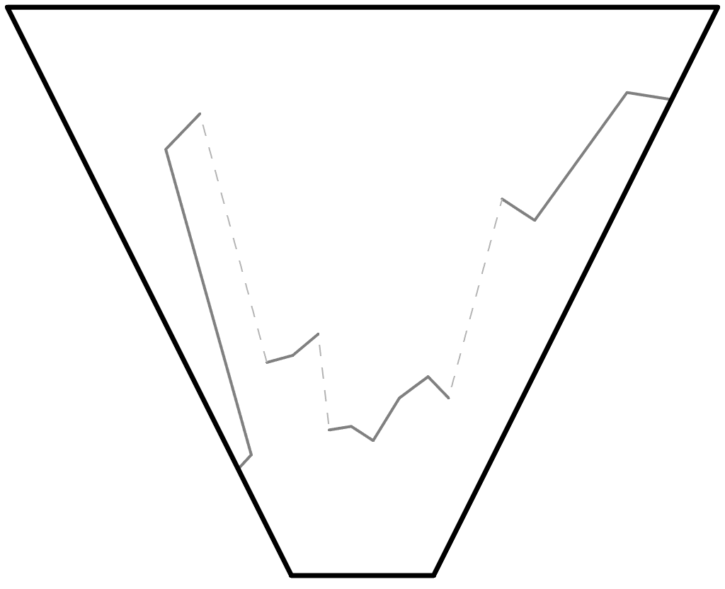
Clustering and depth
Sample frustum with depths
Notes:
Let’s discuss the problem of depth discontinuities and illustrate how clustered shading solves it. Here’s a sample frustum with some depth values, including a few discontinuities.

Slide 20
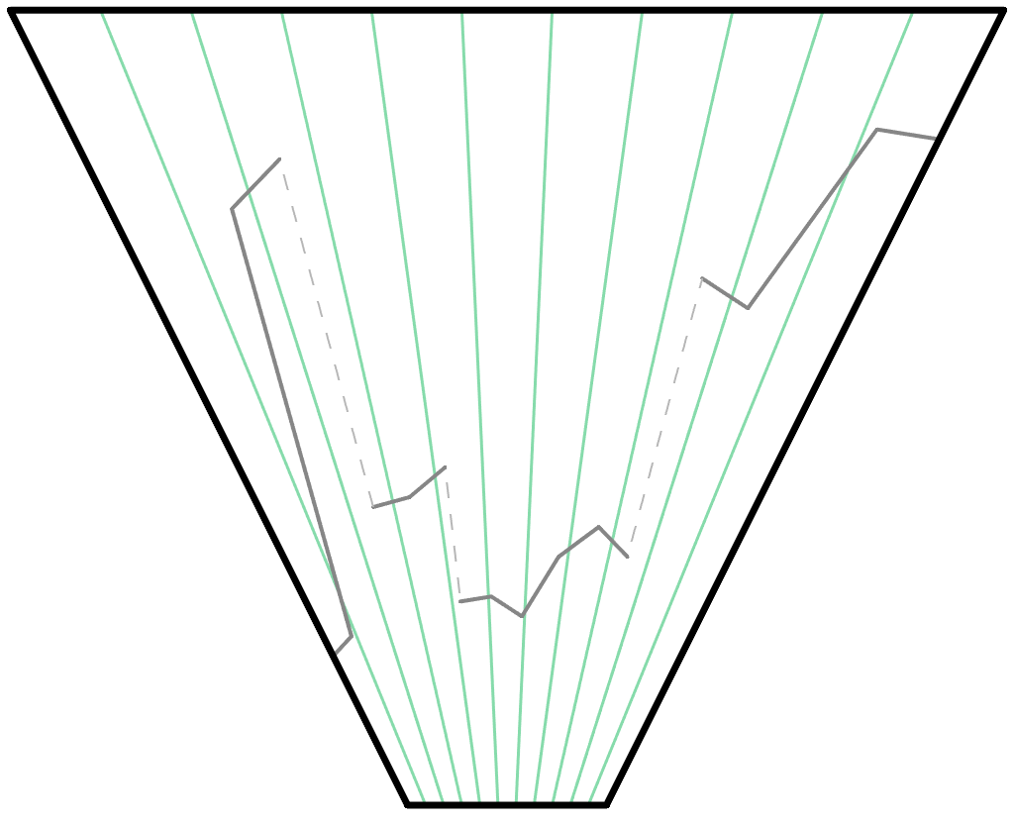
Clustering and depth
Tiled frustum
Notes:
Here we added the tiles.

Slide 21
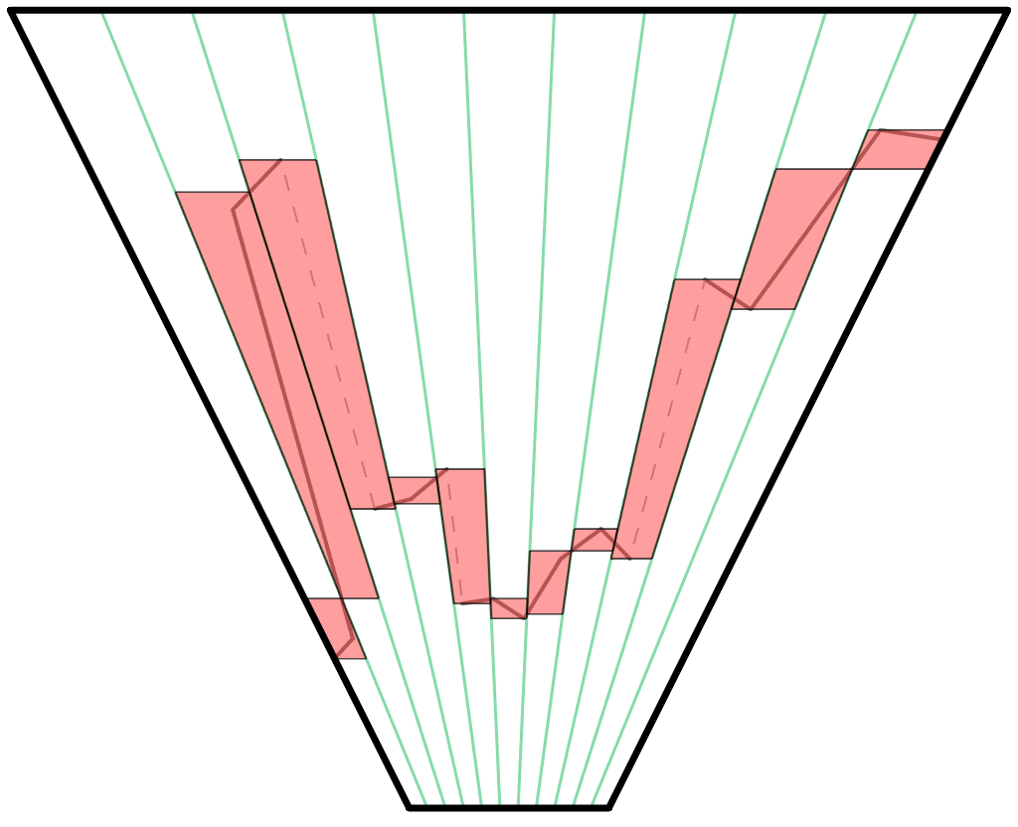
Clustering and depth
Depth ranges for Tiled Deferred / Forward+
Notes:
And this is the depth ranges you would get for a plain tiled shading algorithm. Clearly some ranges are fairly large.

Slide 22
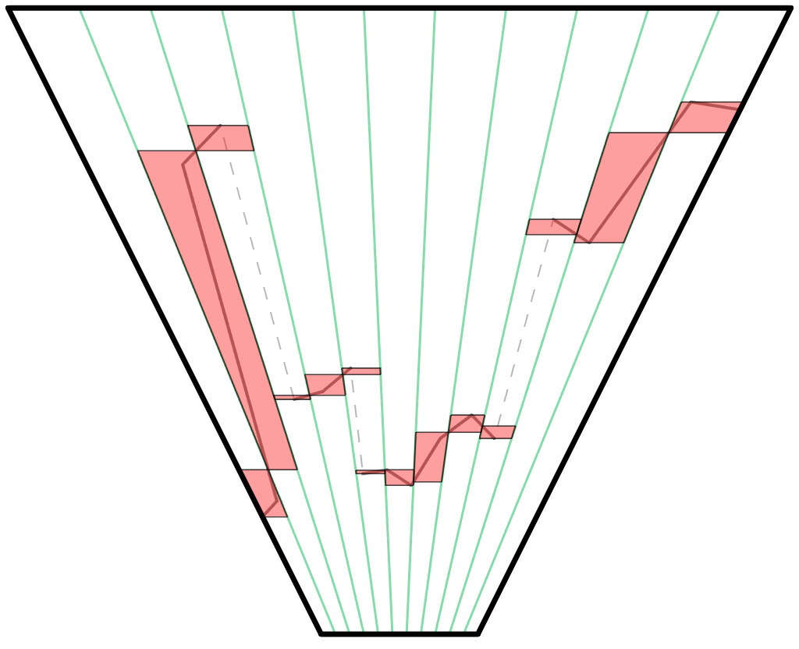
Clustering and depth
Depth ranges for Tiled Deferred / Forward+ with 2.5D culling
Notes:
With 2.5D culling the situation is notably improved. Now lights in the discontinuity area is not included. However, we do pay the full cost lights at both ends for both sides of the discontinuity. Also note that one very long depth range remains. This is because it’s not discontinuous, it’s a continuous slope. This situation would happen if you look down a hallway, or the ground plane, or moderate large surface at a grazing angle.

Slide 23
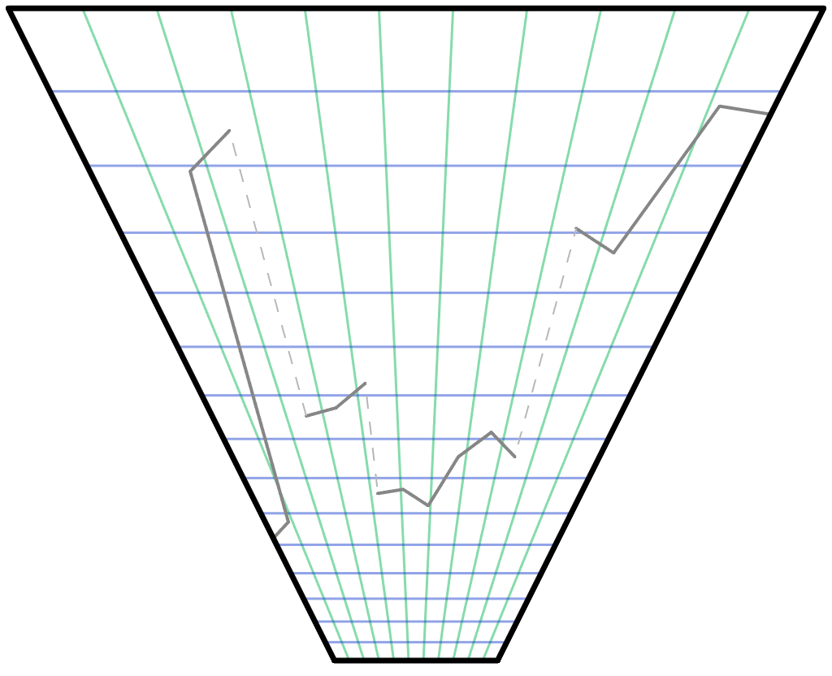
Clustering and depth
Clustered frustum
Notes:
Now let’s look at a clustered frustum.

Slide 24
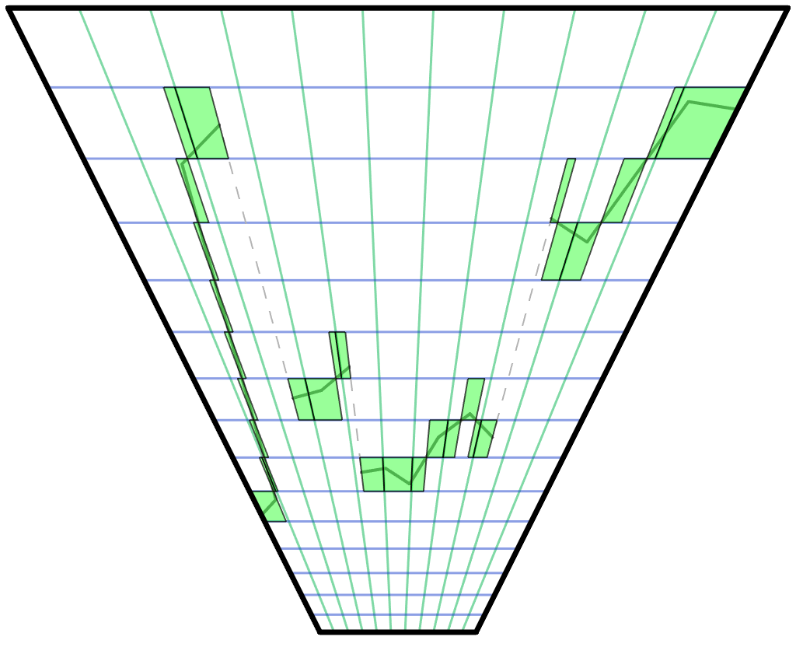
Clustering and depth
Implicit depth ranges for clustered shading
Notes:
These are the depth ranges that we will need to consider. Note that we are paying for exactly one cluster’s depth at any given point.

Slide 25
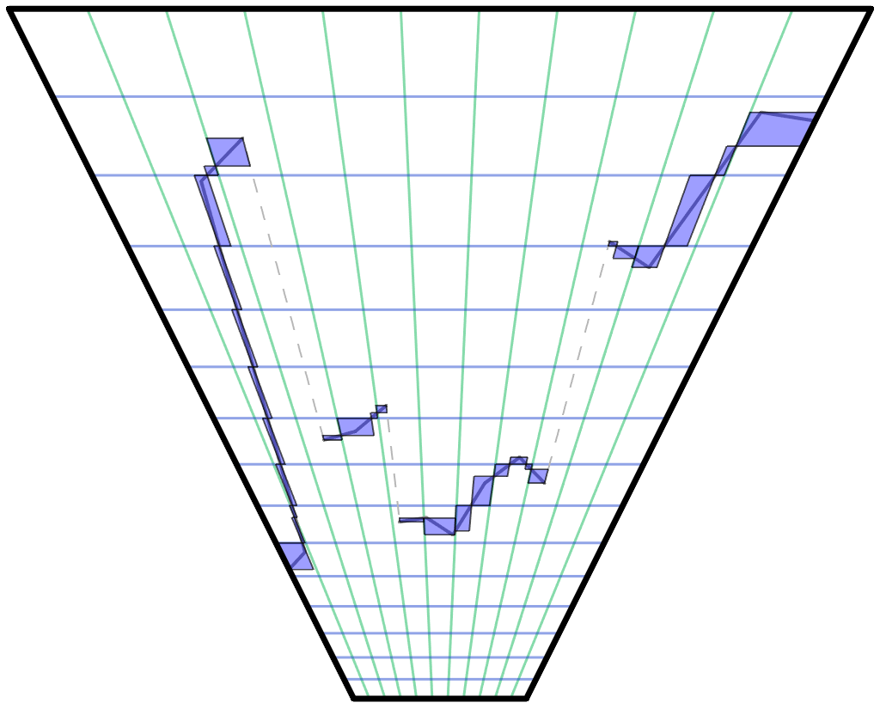
Clustering and depth
Explicit depth ranges for clustered shading
Notes:
If we go to explicit cluster bounds, the situation is even further improved, although in practice there may not be a huge difference between a fairly small range and an even smaller range, depending on the typical size of light sources.

Slide 26
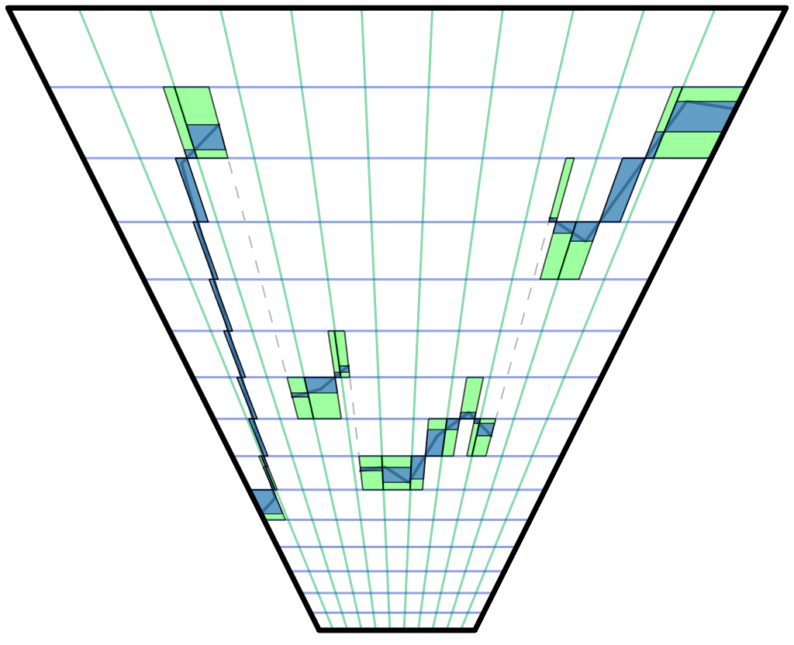
Clustering and depth
Explicit versus implicit depth ranges
Notes:
Here we see the improvement from implicit bounds to explicit.

Slide 27
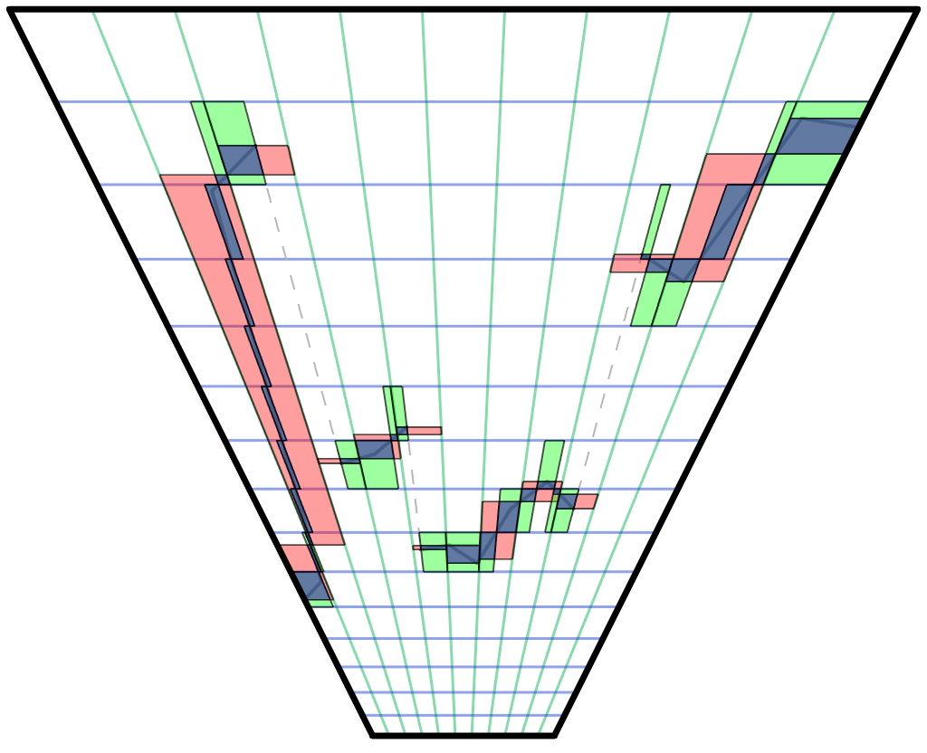
Clustering and depth
Tiled vs. implicit vs. explicit depth ranges
Notes:
And here all techniques are compared. As you can see, explicit clustered is always the tightest. However, there are definitively areas where tiled is tighter than implicit cluster bounds. So in scenes with little depth complexity tiled could very well be faster. However, implicit clustered bounds does not have any areas that are extremely bad, regardless of depth complexity, and would thus perform more consistently. Most importantly, it’s worst case performance is much better than tiled.

Slide 28
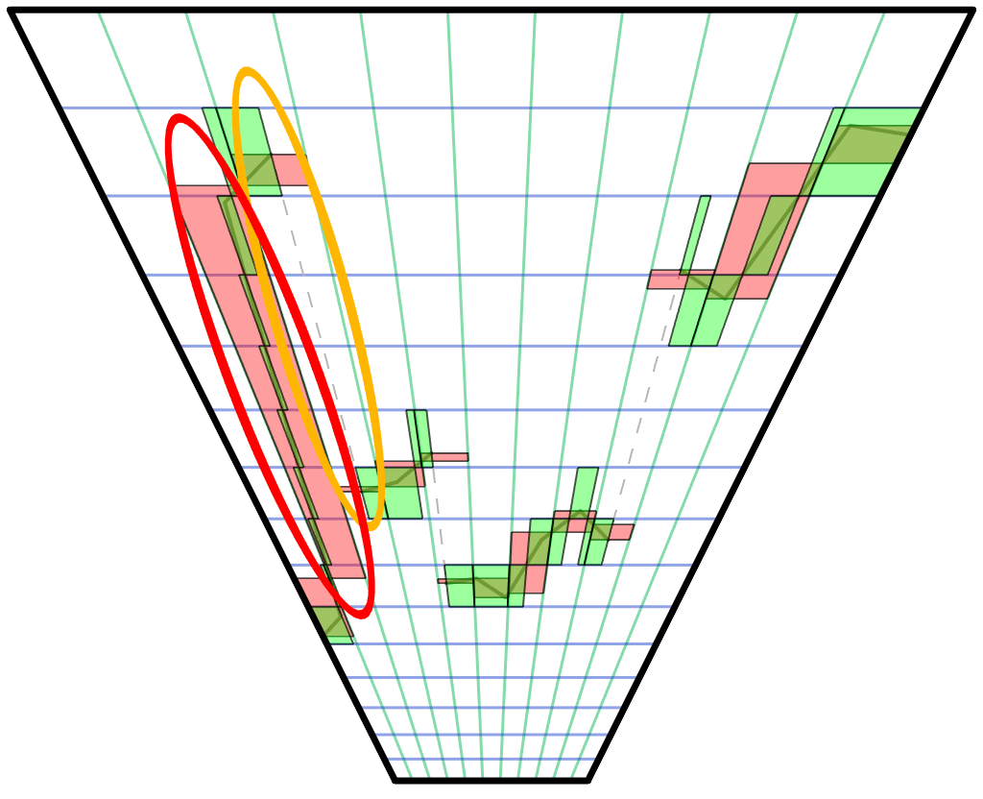
Wide depths
Depth discontinuity range A to F
Default Tiled: A+B+C+D+E+F
Tiled with 2.5D: A + F
Clustered: ~max(A, F)
Depth slope range A to F
Default Tiled: A+B+C+D+E+F
Tiled with 2.5D: A+B+C+D+E+F
Clustered: ~max(A, B, C, D, E, F)
Notes:
Here we can see the impact of adding 2.5D culling to a tiled technique. While it helps in the discontinuity case (although does not reach clustered’s performance), it doesn’t help much or at all in a depth slope situation.

Slide 29
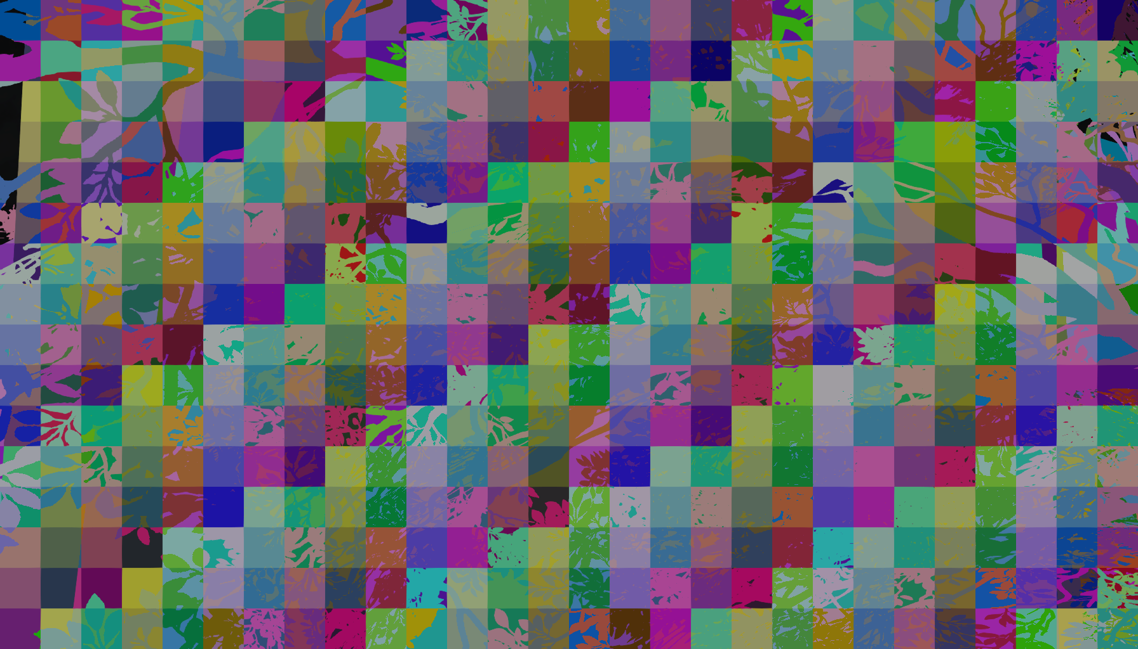
Data coherency
Notes:
So the difference between tiled and clustered is that we pick a light list on a per-pixel basis instead of per-tile. So if we visualize what light lists were chosen, we can see that there are a bunch of different paths taken beyond just the tile boundaries. A number of depth discontinuities from the foliage in front of the player gets clearly visible. This may seem like a big problem, but here we are only talking about fetching different data. This is not a problem for a GPU, it’s something they do all the time for regular texture fetches, and this is even much lower frequency than that.

Slide 30

Branch coherency
Notes:
The thing you might worry about though is divergent branches. However, despite fetching different light lists from pixel to pixel, the situation is not nearly as bad as you might expect from the previous picture. Chances are that the light lists look fairly similar. If you have one light lists with 5 lights and another with 5 lights (that are not necessarily the same as the other ones), branching will still be 100% coherent. You may pay a small overhead from the ideal when the lists have different light count, but that is typically going to be a relatively small overhead. In the worst-case scenario (no coherency at all), the amount of shading essentially boils down to what tiled shading has to shade.

Slide 31
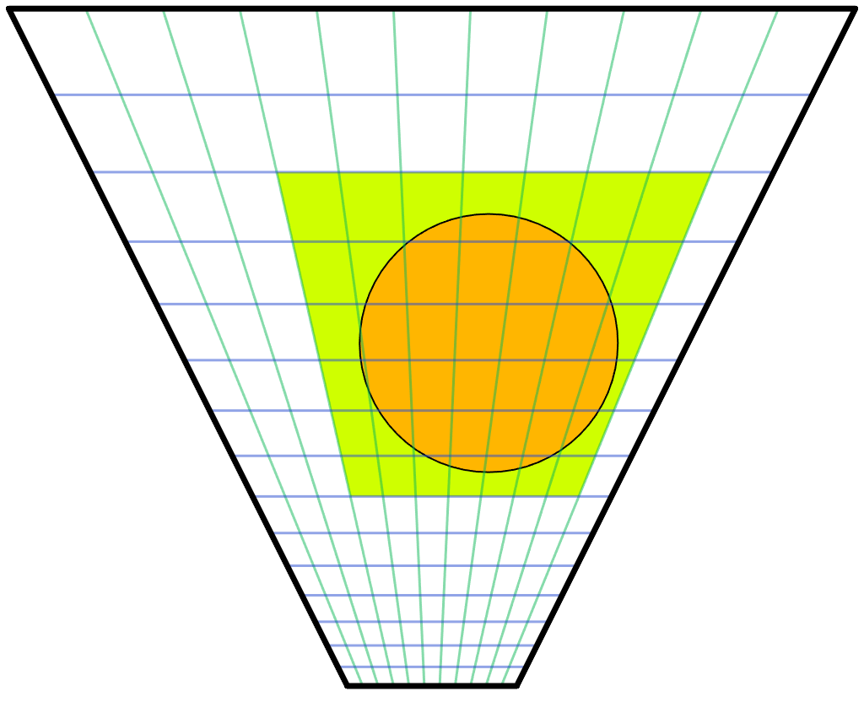
Culling
Want to minimize false positives
Must be conservative
But still tight
Preferably exact
But not too expensive
Surprisingly hard!
99% frustum culling code useless
Made for view-frustum culling
Large frustum vs. small sphere
We need small frustum vs. large sphere
Sphere vs. six planes won't do
Notes:
Our light sources are typically artist placed, scaled for human environments in an outdoor world, so generally speaking from meters to tens of meters. So a light source generally intersects many clusters. The typical sphere-frustum tests that you can find online are not suitable for this sort of culling. They are made for view-frustum culling and based on the assumption that the frustum typically is much larger than the sphere, which is the opposite of what we have here. Typically they simply test sphere vs plane for each six planes of the frustum. This is conservative, but lets through spheres that aren’t completely behind any of the planes, such as in the frustum corners. The result you get is that green rectangle, or essentially a ”cube” of clusters around the light. But that’s also the first thing we compute. We simply compute the screen-space and depth extents of the light analytically first, so this test doesn’t actually help anything at all after that.

Slide 32
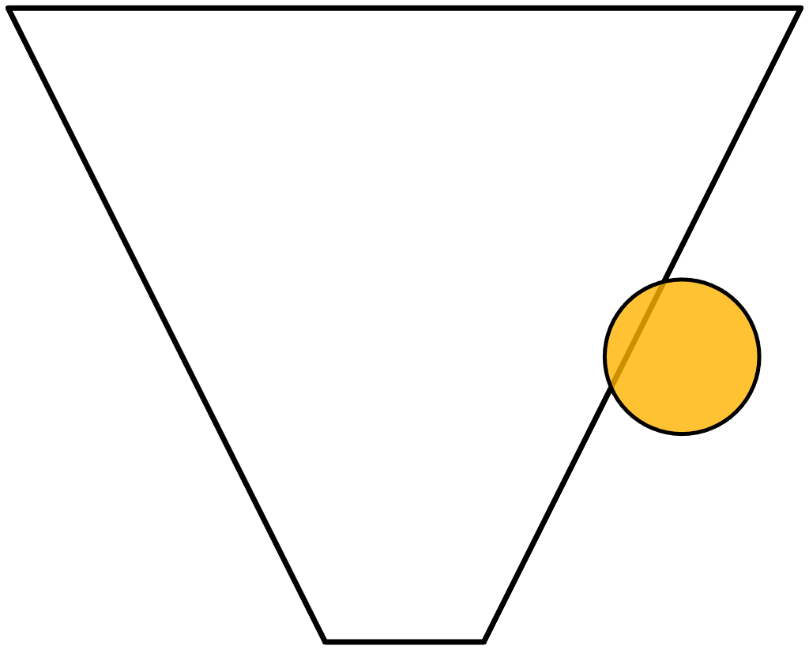
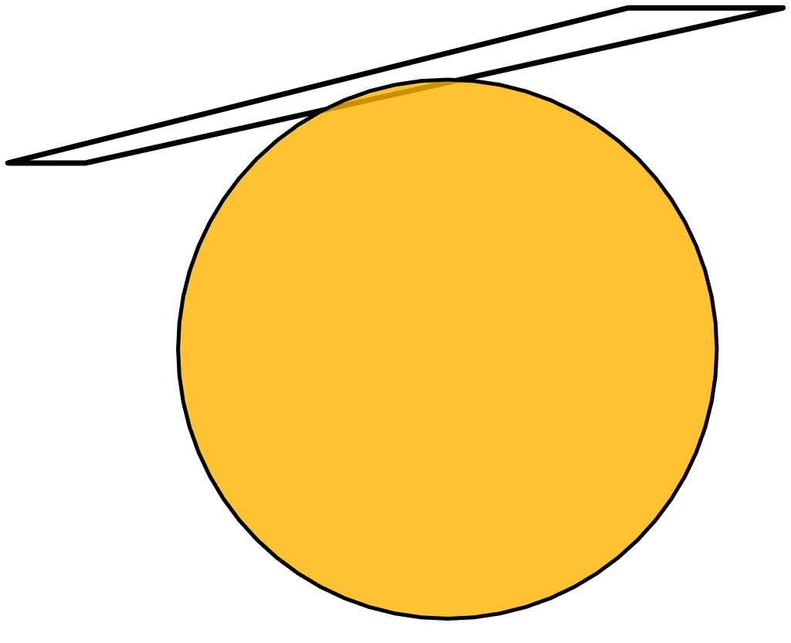
Culling
Your mental picture of a frustum is wrong!
Notes:
Most frustum culling code is written with the scenario on the left in mind. We need to handle the scenario on the right.

Slide 33
Culling
“Fun” facts:
A sphere projected to screen is not a circle
A sphere under projection is not a sphere
The widest part of a sphere on screen is not aligned with its center
Cones (spotlights) are even harder
Frustums are frustrating (pun intended)
Workable solution:
Cull against each cluster's AABB
Notes:
One way to go about frustum culling is testing all planes, all edges and all vertices. This would work, but be too costly to outweigh the gains from fewer false positives. A fast, conservative but relatively tight solution is what we are looking for. There are many approaches that seem fitting, but there are also many complications, which has ultimately thrown many of our attempts into the garbage bin. One relatively straightforward approach is to cull against the cluster’s AABB. This is fast and gives fairly decent results, but it’s possible to do better.

Slide 34
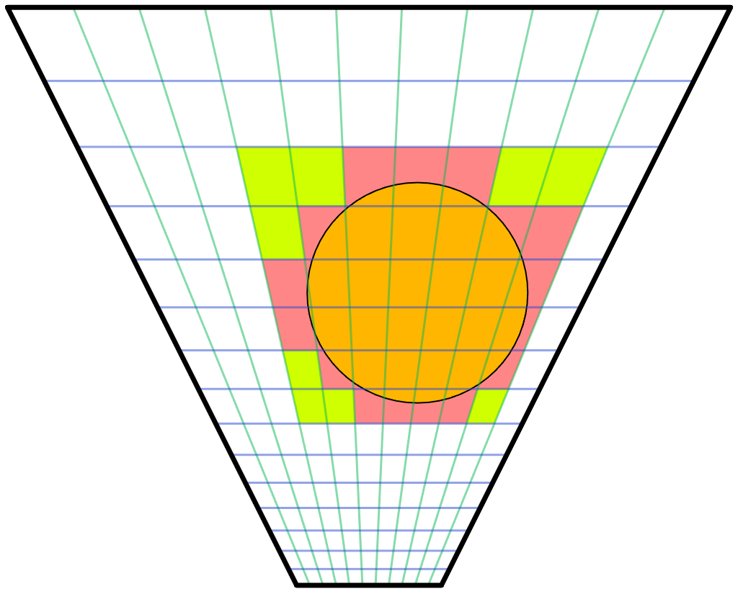
Pointlight Culling
Our approach
Iterative sphere refinement
Loop over z, reduce sphere
Loop over y, reduce sphere
Loop over x, test against sphere
Culls better than AABB
Similar cost
Typically culling 20-30%
Notes:
Starting with the ”cube” of clusters around the light, in our outer loop we iterate over the slices in z direction. We intersect the sphere with the slice where it is the widest. This results in a circle of a smaller radius than the original sphere, we thus continue in the y direction using a sphere of this smaller radius and the circle’s midpoint. In the center slice we simply proceed with the original sphere. We repeat this procedure in y and have an even smaller sphere. Then in the inner loop we do plane vs. sphere tests in x direction to get a strip of clusters to add the light to.
To optimize all the math we take advantage of the fact that in view-space, all planes will have components that are zero. A plane in the x direction will have zero y and offset, y direction has zero x and offset, and z-direction is basically only a z offset.
The resulting culling is somewhat tighter than a plain AABB test, and costs about the same. Where AABB culls around 15-25%, this technique culls around 20-30% from the “cube” of clusters.

Slide 35
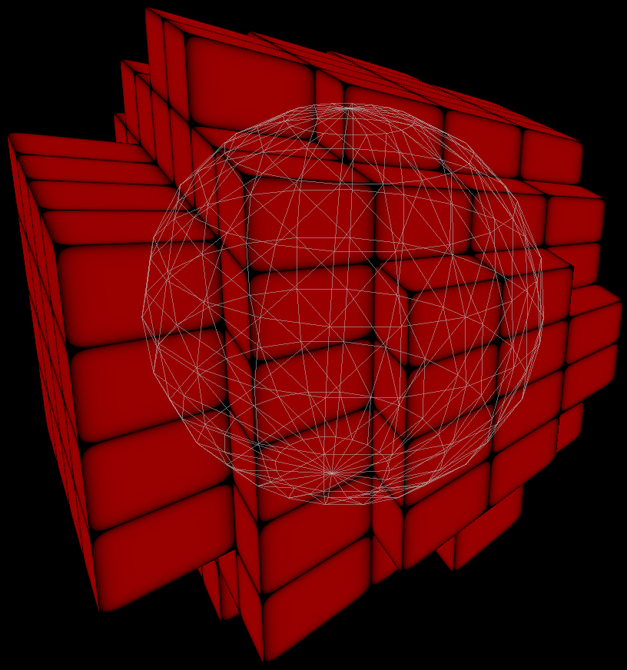
Pointlight Culling
Notes:
Here’s the result visualized in 3D.

Slide 36
Culling pseudo-code
for (int z = z0; z <= z1; z++) {
float4 z_light = light;
if (z != center_z) { // Use original in the middle, shrunken sphere otherwise
const ZPlane &plane = (z < center_z)? z_planes[z + 1] : -z_planes[z];
z_light = project_to_plane(z_light, plane);
}
for (int y = y0; y < y1; y++) {
float3 y_light = z_light;
if (y != center_y) { // Use original in the middle, shrunken sphere otherwise
const YPlane &plane = (y < center_y)? y_planes[y + 1] : -y_planes[y];
y_light = project_to_plane(y_light, plane);
}
int x = x0; // Scan from left until with hit the sphere
do { ++x; } while (x < x1 && GetDistance(x_planes[x], y_light_pos) >= y_light_radius);
int xs = x1; // Scan from right until with hit the sphere
do { --xs; } while (xs >= x && -GetDistance(x_planes[xs], y_light_pos) >= y_light_radius);
for (--x; x <= xs; x++) // Fill in the clusters in the range
light_lists.AddPointLight(base_cluster + x, light_index);
}
}
Notes:
This shows the gist of the culling code.

Slide 37
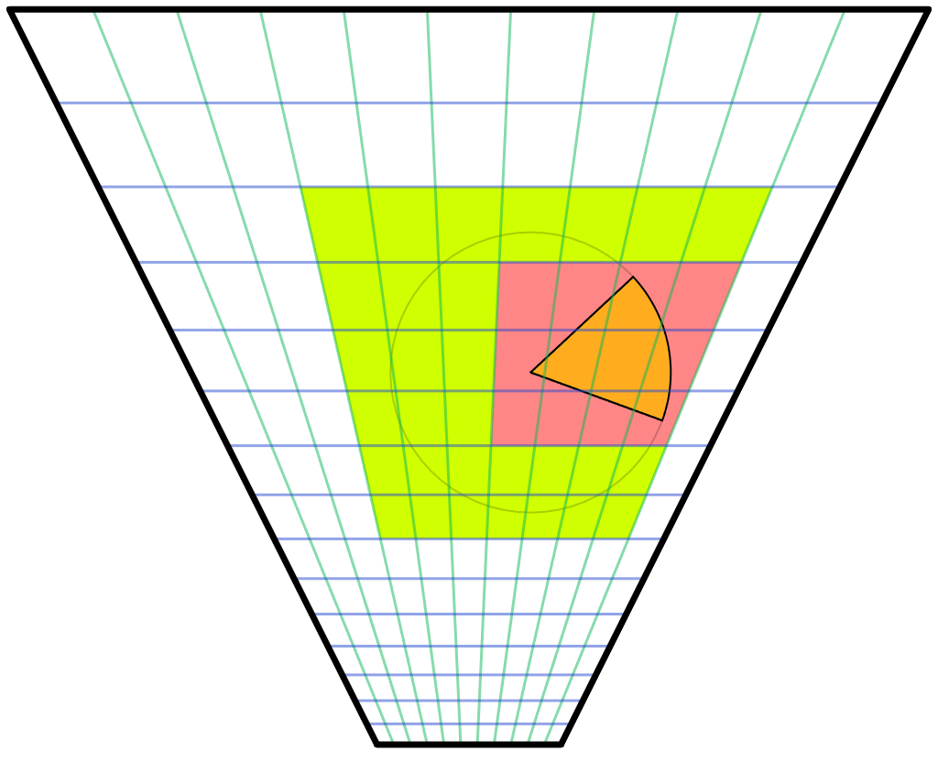
Spotlight Culling
Our approach
Iterative plane narrowing
Find sphere cluster bounds
In each six directions, do plane-cone test and shrink
Cone vs. bounding-sphere cull remaining “cube”
Notes:
For spotlights we begin by finding the ”cube” of clusters around the light’s sphere, just like for pointlights, except this cube typically is much larger than necessary for a spotlight. However, this analytical test is cheap and goes a long way to limit the search space for following passes. Next we find a tighter ”cube” simply by scanning in all six directions, narrowing it down by doing plane-cone tests. There is likely a neat analytical solution here, but this seemed non-trivial. Given that the plane scanning works fine and is cheap we haven’t really explored that path.
Note that our cones are sphere-capped rather than flat-capped. That’s because the light attenuation is based on distance (as it should), rather than depth. Sphere-capped cones also generally behave much better for wide angles and doesn’t become extremely large as flat-capped cones can get.

Slide 38

Spotlight Culling
Our approach
Iterative plane narrowing
Find sphere cluster bounds
In each six directions, do plane-cone test and shrink
Cone vs. bounding-sphere cull remaining “cube”
Notes:
Finally, for the remaining ”cube” of clusters we cull each cluster with a sphere-capped cone vs. bounding sphere test. For this to work well we have to have relatively cubical shaped clusters, otherwise the bounding sphere becomes way oversized. Overall this technique results in a moderately tight culling that is good enough for us so far, although there is room for some minor improvement.

Slide 39
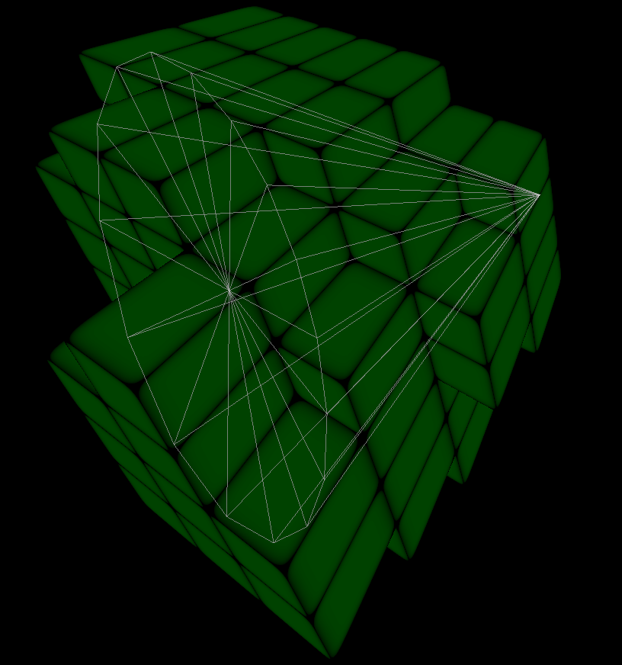
Spotlight Culling
Notes:
Here’s the result visualized in 3D. Although our spotlights are sphere-capped, our debug visualization still draws them as flat-capped. That’s why it might look like it’s extending a bit outside the clusters.

Slide 40
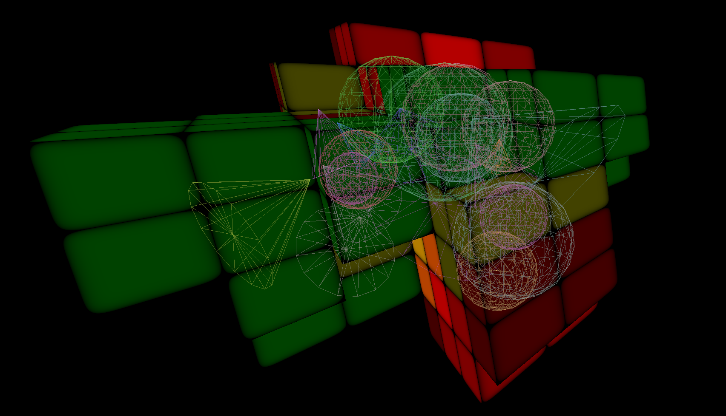
Pointlights and spotlights
Notes:
Here’s the result with a handful of pointlights and spotlights enabled in a scene. The number of pointlights goes into red, and number of spotlights into green.

Slide 41
Shadows
Needs all shadow buffers upfront
Unlike classic deferred …
Memory less of a problem on next-gen
One large atlas
Variable size buffers
Dynamically adjustable resolution
Lights are cheap, shadow maps are not
Still need to be conservative about shadow casters
Notes:
Classic deferred has the advantage that you can iterative light by light, and thus reuse resources such as shadow buffers in between. This saves some memory, which may be needed on current generation consoles. On PC and next-generation consoles this is not nearly as big a problem.
With the switch to clustered shading the cost of adding a new light to the scene is small. Artists can now be moderate ”wasteful” without causing much problems performance-wise. This is not true for shadow casters. They remain expensive, and relatively speaking going to be more expensive going forward since it’s often a ROP-bound process, and ROPs aren’t getting scaled up nearly as much as ALU. So we still need to be a bit conservative about how many shadow casting lights we add to the scene.
An observation that was made is that artists often place very similar looking lights close to each other. In some cases it is to get a desired profile of a light, in which case the two lights may in fact be centered at the exact same point. But often it is motivated by the real world, such as two headlights on car. Some vehicles actually have ten or more lights, all pointing in the same general direction. Rendering ten shadow buffers for that may prove to be far too expensive.

Slide 42
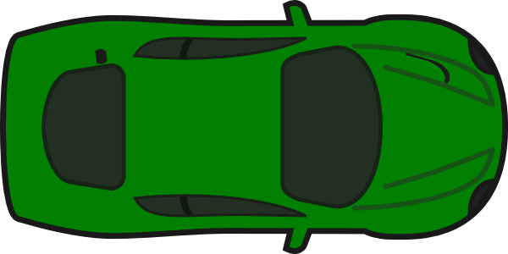
Shadows
Decouple light and shadow caster
Similar lights can share shadow caster
Encode shadow caster in light index
e.g. 12bits light-index, 4bits shadow-index
Notes:
Often is works just fine to share a single shadow caster for these lights. While the shadow may be slightly off, this is usually not something that you will notice unless you are specifically looking for it. To make this work we decouple the shadow caster from the light, and make the shadow caster’s frustum large enough to include all the different lights’ frustums.

Slide 43
CPU Performance
Time in milliseconds on one core. Intel Core i7-2600K.
Notes:
Given that we are doing the light assignment on the CPU, one may suspect that this will become a significant burden for the CPU. However, our implementation is fast enough to actually save us a bunch of CPU time over our previous solution. In a normal artist lit scene we recorded 0.1ms on one core for clustered shading. The old code supporting our previous forward pass for transparency that was still running in our system was still consuming 0.67ms for the same scene, a cost that we can now eliminate.
As of this writing, further optimizations have been made resulting in another 20-30% lower CPU cost than previously.

Slide 44
GPU Performance
Time in milliseconds. Radeon HD 7970.
Notes:
When we have nothing but the sun light in our scene, we incur a small overhead compared to classic deferred shading from looking up our light list and looping zero times. Once a light or two has been entered into the scene clustered shading is typically faster, and in regular artist lit scenes significantly so. Once we go to extreme artificial test cases with hundreds of lights sprinkled randomly in front of the player, clustered scales really well whereas classic deferred gets significantly slower. We have observed cases as large as 5x more expensive, whereas typically for heavy scenes it around 2x. The difference is generally about how slow we can make classic deferred, rather than how fast clustered can be, as the clustered performance stays quite consistent, whereas classic’s performance can very quite a lot depending on the scene.

Slide 45
Future work
Clustering strategies
Screen-space tiles, depth vs. distance
View-space cascades
World space
Allows light evaluation outside of view-frustum (reflections etc.)
Dynamic adjustments?
Shadows
Culling clusters based on max-z in shadow buffer?
Notes:
We did some prototyping on a distance based clustering strategy instead of depth. While this allowed pointlights to be culled efficiently and exactly, this also made the cluster lookup slightly more expensive. The performance gain from an exact test was small enough that only with extreme workloads did we gain back what we lost from slower cluster lookup and we were hard-pressed to find a case where it ended up being faster in practice.
Another possible approach is clustering on view-space cascades. This would allow for exact AABB tests. One could argue that if you are going to test using an AABB, then you might just as well shape your clusters that way.
World-space clusters is another interesting option. While this would utilize the available clusters worse, the light distribution might match real world better. The other advantage is that you could evaluate light outside of the view frustum. This would allow for instance a reflection pass (such as a rear-view mirror) to use the same lighting structure for light evaluation.
There may be performance gains to be had if we consider the actual lights we have when clustering. For instance, we could tighten the cluster bounds if the most distant light active is closer than 500m, and the closest one more distant than 5m. This would allow for better cluster utilization.
Finally, a quick conservative reduction of the depth values in a shadow buffer could allow us to cull some clusters based on a conservative maximum-z value over some range. Whether this would result in any actual performance gains is unclear though.

Slide 46
Conclusions
Clustered shading is practical for games
It's fast
It's flexible
It's simple
It opens up new opportunities
Evaluate light anywhere
Ray-trace your volumetric fog
Notes:
What are you waiting for? Start writing your clustered shader today! ☺

Slide 47

Questions?
@_Humus_
emil.persson@avalanchestudios.se

